Slide 1

Customer Shopping Behavior Analysis
Dataset: 3,900 customer transactions
Goal: Uncover spending patterns and customer segments
Tools: Python, SQL, Power BI

Slide 2
Project Overview & Dataset Summary
3,900 purchases across multiple categories
18 data columns including demographics and behavior
37 missing values in Review Rating (handled via median imputation)
Key features: age groups, purchase frequency, subscription status

Slide 3
Data Preparation & Cleaning
Data Preparation & Cleaning Steps
01
02
Data Loading
Missing Data Handling
(pandas)
(median imputation)
03
04
Column Standardization
Feature Engineering
(snake_case)
(age_group, purchase_frequency_days)
05
06
Data Consistency Check
Database Integration
(removed redundant columns)
(PostgreSQL)

Slide 4

Key Business Insights from SQL Analysis
Revenue by Gender: Male customers generated $157,090 vs Female $75,191
Top Products by Rating: Gloves (3.86), Sandals (3.84), Boots (3.82)
Shipping Impact: Express shipping averages $60.48 vs Standard $58.46
Subscription Advantage: Subscribers show strong loyalty patterns

Slide 5
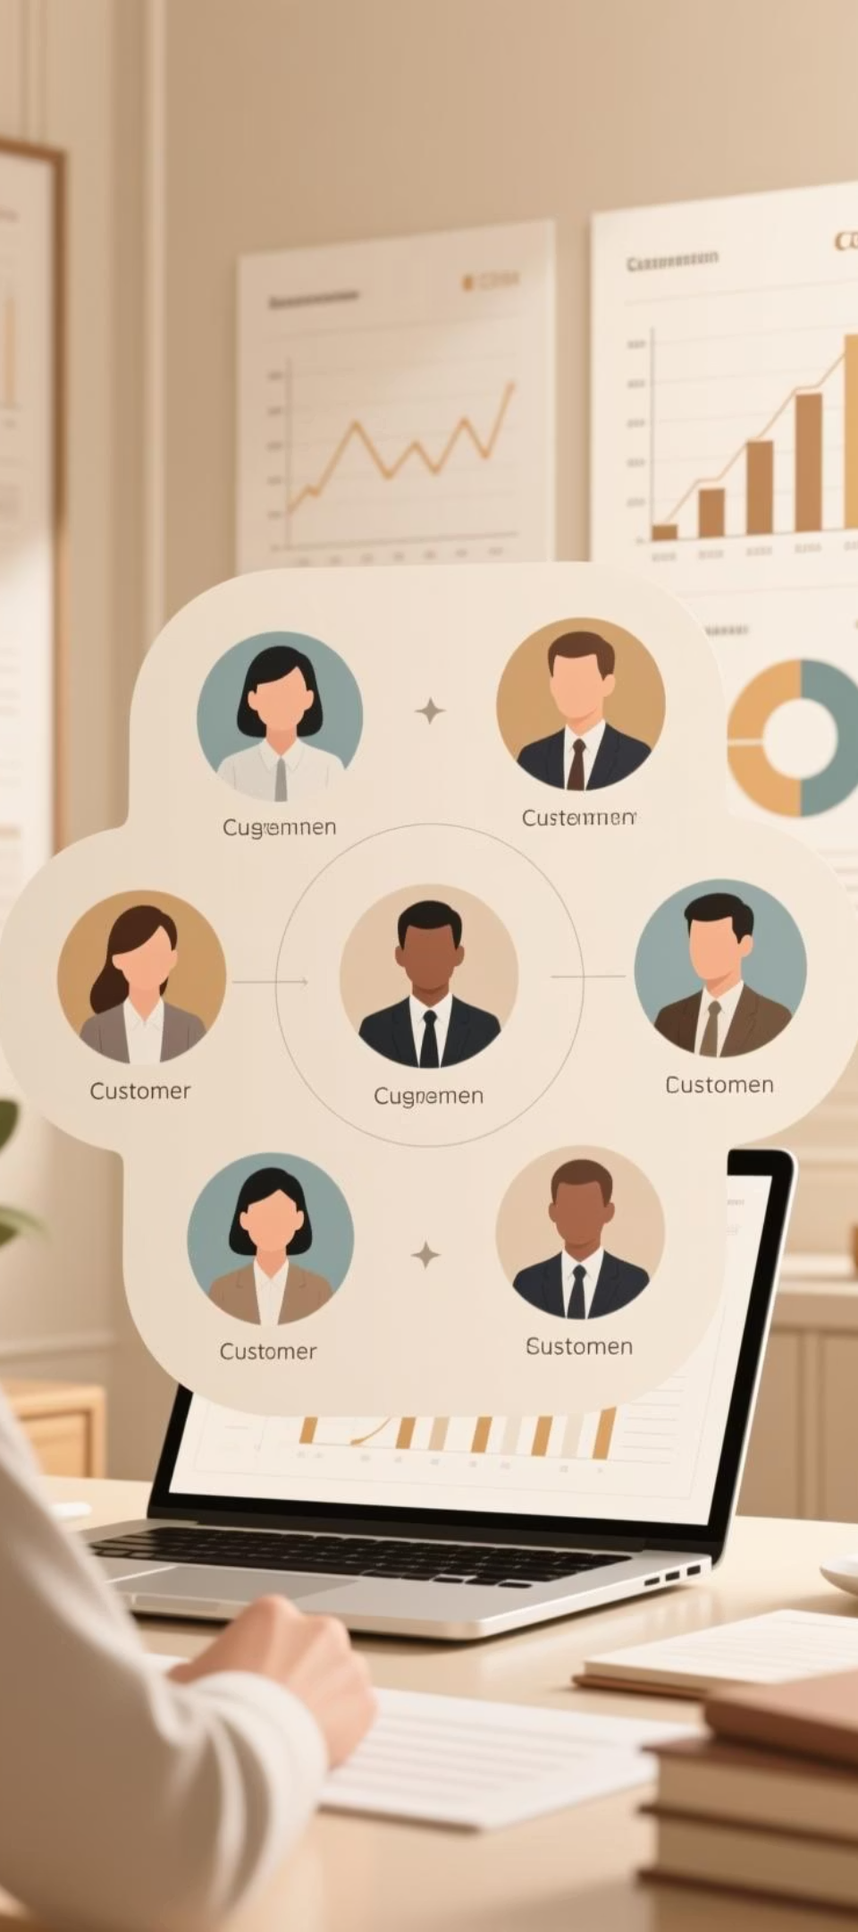
Customer Segmentation Analysis
Our recent analysis categorizes customers into distinct segments, revealing valuable insights for targeted strategies.
1
Loyal Customers: 3,116 (79.8%)
2
Returning Customers: 701 (17.9%)
3
New Customers: 83 (2.1%)
4
Insight: Focus on converting Returning to Loyal segment

Slide 6

Discount Dependency & Top Products
Our analysis reveals key insights into product performance and customer behavior related to discounts.
Top Discount-Dependent Products: Hat (50%), Sneakers (49.66%), Coat (49.07%)
High-Spending Discount Users: 160 customers spent above average despite discounts
Top 3 Products per Category: Jewelry (171 orders), Blouse (171 orders), Sandals (160 orders)

Slide 7

Revenue Breakdown
Revenue Analysis by Demographics
By Age Group
Young Adults lead with $62,143, followed by Middle-aged ($59,197)
By Subscription
Non-subscribers generate $170,436 (73%) vs Subscribers $62,645 (27%)
By Gender
Male customers contribute significantly more to total revenue

Slide 8

Strategic Recommendations
Boost Subscriptions
Promote exclusive benefits for subscribers.
Customer Loyalty Programs
Reward repeat buyers to move them into Loyal segment.
Review Discount Policy
Balance sales boosts with margin control.
Product Positioning
Highlight top-rated products in campaigns.
Targeted Marketing
Focus on high-revenue age groups and express-shipping users.

Slide 9

Key Takeaways
Young Adults are the highest revenue contributors
Loyal customers represent 80% of the customer base
Discount strategy needs refinement to protect margins
Subscription model has growth potential
Data-driven decisions can optimize marketing spend

